Slide 1
Systems Analysis and Design 10th Edition
Chapter 3
Managing Systems Projects

Slide 2
Chapter Objectives
Explain project planning, scheduling, monitoring, and reporting
Draw a project triangle that shows the relationship among project cost, scope, and time
Describe work breakdown structures, task patterns, and critical path analysis
Explain techniques for estimating task completion times and costs

Slide 3
Chapter Objectives (Cont.)
Describe various scheduling tools, including Gantt charts and PERT/CPM charts
Analyze task dependencies, durations, start dates, and end dates
Describe project management software and how it can assist you
Discuss the importance of managing project risks
Understand why projects sometimes fail

Slide 4
Overview of Project Management
What Shapes a Project?
Successful projects must be completed on time, within budget, meet requirements, and satisfy users
What Is a Project Triangle
Cost, scope, time
Usually one of these is fixed
A budget cast in stone
An inflexible scope
A schedule fixed by factors beyond the firm’s control

Slide 5
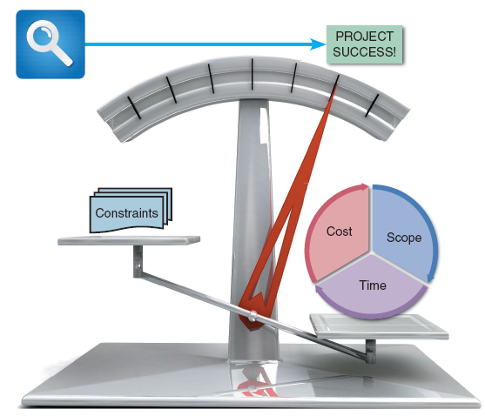
Overview of Project Management(Cont.)
What Does a Project Manager Do?
Good leadership is essential
Project planning
Identify all project tasks and estimate the completion time and cost of each
Project scheduling
Create a specific timetable that shows tasks, task dependencies, and critical tasks that might delay the project
FIGURE 3-3 A successful project must balance cost, scope, and time against a set of constraints. In this example, the project appears to be a success

Slide 6
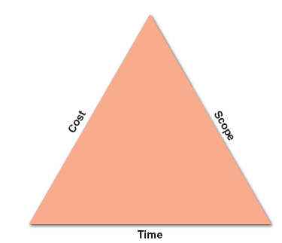
Overview of Project Management(Cont.)
What Does a Project Manager Do? (Cont.)
Project monitoring
Guiding, supervising, and coordinating the project team’s workload
Project reporting
Create regular progress reports to management, users, and the project team itself
FIGURE 3-5 A typical project triangle includes
cost, scope, and time

Slide 7
Project Management Objectives
Define the Project
Reduce project to set of manageable tasks
Obtain appropriate resources
Build a team(s) to perform the work
Plan the work & allocate resources to tasks-adapt plan as necessary
Monitor and control the work
Report progress to project supervisor, stakeholders
Interact with users
Close down project
Review project & learn lessons

Slide 8
Project Management is a Team Sport

Slide 9
Project Manager
Responsible for ensuring the Team completes the project
Helps develop Project Plan
Manages performance of tasks
Secures acceptance and approval of deliverables
Communication
Status reporting
Risk management
Escalation of issues that cannot be resolved in the team
Make sure project is delivered in budget, on schedule, and within scope

Slide 10
Step 1: Create a Work Breakdown Structure
What Is a Gantt Chart?
Developed by mechanical engineer and management consultant Henry L. Gantt almost 100 years ago
Shows planned and actual progress on a project
Time usually displayed on horizontal axis
Tasks shown on vertical axis

Slide 11
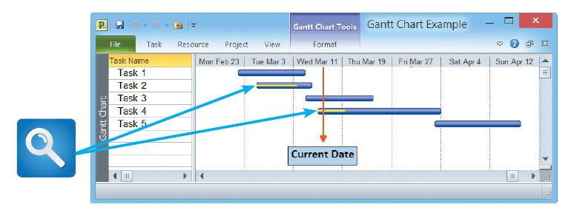
Step 1: Create a Work Breakdown Structure (Cont.)
FIGURE 3-6 In this Gantt chart, notice the yellow bars that show the percentage of task completion

Slide 12
Step 1: Create a Work Breakdown Structure (Cont.)
What Is a PERT/CPM Chart?
Program Evaluation Review Technique (PERT)
Developed by the U.S. Navy to manage complex projects
Critical Path Method (CPM)
Similar to PERT, developed by private industry
Most analysts call both a PERT Chart

Slide 13
Step 1: Create a Work Breakdown Structure (Cont.)
Which is better: Gantt vs. PERT
Gantt offers a valuable snapshot view of the project
PERT is more useful for scheduling, monitoring, and controlling the actual work
PERT displays complex task patterns and relationships
PERT chart boxes can provide more detailed information

Slide 14
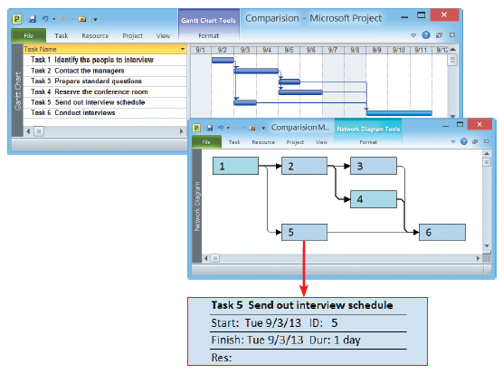
Step 1: Create a Work Breakdown Structure (Cont.)
FIGURE 3-7 The top screen shows a Gantt chart with six tasks. The PERT
chart in the bottom screen displays an easy-to-follow task pattern for the same project. When the user mouses over the summary box for Task 5, the details become visible

Slide 15
Step 1: Create a Work Breakdown Structure (Cont.)
Identifying Tasks in a Work Breakdown Structure (WBS)
WBS must clearly identify each task and include an estimated duration
A task, or activity, is any work that has a beginning and an end and requires the use of company resources such as people, time, or money
Tasks are basic units of work that the project manager plans, schedules, and monitors — so they should be relatively small and manageable

Slide 16
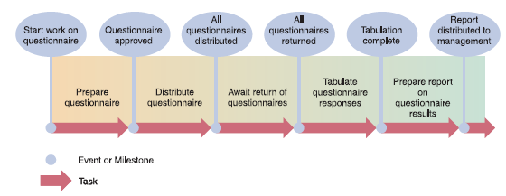
Step 1: Create a Work Breakdown Structure (Cont.)
FIGURE 3-8 Using a questionnaire requires a series of tasks and events to
track the progress. The illustration shows the relationship between the tasks and
the events, or milestones, that mark the beginning and end of each task

Slide 17
Step 1: Create a Work Breakdown Structure (contd)
Breaking down the individual tasks:
First reserve the meeting room. Then order the marketing materials and brief the managers. After the briefings, send out customer e-mails and burn sample DVDs. When the e-mails are sent and the DVDs are ready, load the new software. When the marketing materials have arrived and the software is ready, do a dress rehearsal.

Slide 18
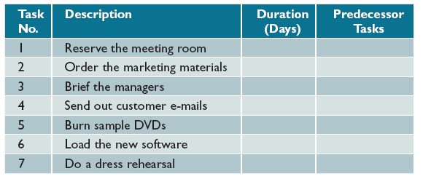
Step 1: Create a Work Breakdown Structure (Cont.)
Listing the Tasks
List all tasks
Put tasks in order
Add a description
Decide how long each task takes
Decide which tasks must go first
FIGURE 3-10 In this table, columns have been added for task number, description, duration, and predecessor tasks, which must be completed before another task can start
Notes:
Clearly shows what must be completed first before the next task is started

Slide 19
Step 1: Create a Work Breakdown Structure (Cont.)
Estimating Task Duration
Tasks can be hours, days, or weeks
If tasks uses days, the units of measurement are called person-days
A person-day = the work that one person can complete in one day

Slide 20
Step 1: Create a Work Breakdown Structure (contd)
Project manager works with 3 time estimates:
Best-Case estimate (optimistic)
Probable-Case estimate (normal)
Worst-Case estimate (pessimistic)
Then using a formula –see page 96 in your text, the manager can come up with a time expected to complete the task

Slide 21
Step 1: Create a Work Breakdown Structure (Cont.)
Factors Affecting Duration
Project Size
Must identify all project tasks, from initial fact-finding to system implementation
How much time will be needed to perform each task?
Allow time for meetings, project reviews, training, and any other factors that could affect the productivity of the development team
Human Resources
Assemble and guide a development team that has the skill and experience to handle the project
Turnover, job vacancies, and escalating salaries in the technology sector

Slide 22
Step 1: Create a Work Breakdown Structure (Cont.)
Displaying the Work Breakdown Structure
Experience with Similar Projects
Develop time and cost estimates based on the resources used for similar, previously developed information systems
Use experience from projects that were developed in a different environment
Constraints
Constraints are conditions, restrictions, or requirement that the system must satisfy
Define system requirements that can be achieved realistically within the required constraints

Slide 23
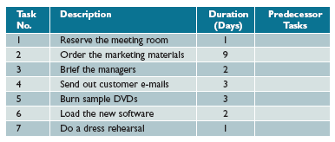
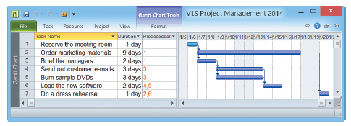
Step 1: Create a Work Breakdown Structure (Cont.)
FIGURE 3-11 Task durations have been added, and the WBS is complete except for
predecessor task information. The predecessor tasks will determine task patterns and
sequence of performance
FIGURE 3-12 This Microsoft Project screen displays the same WBS, including task number, task name,
duration, and predecessor tasks

Slide 24
Step 2: Identify Task Patterns
What Are Task Patterns
Tasks depend on each other and must be performed in a sequence
Involve dependent tasks, multiple successor tasks, and multiple predecessor tasks
How Do I Use Task Boxes to Create a Model?
Each section of the task box contains important information about the task, including the task name, task ID, task duration, start day/date, and finish day/date

Slide 25

Step 2: Identify Task Patterns(Cont.)
Task Name
Should be brief and descriptive
Task ID
Can be a number or code that provides unique identification
Task Duration
Amount of time it will take to complete a task
Start Day / Date
The start day/date is the time that a task is scheduled to begin
Finish Day / Date
The finish day/date is the time that a task is scheduled to be completed
FIGURE 3-13 Each section of the task
box contains important information about the task, including the Task Name, Task ID, Task Duration, Start Day/Date, and Finish Day/Date

Slide 26
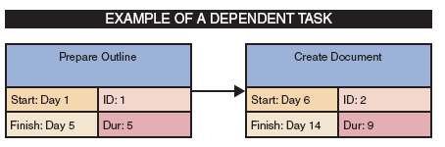
Step 2: Identify Task Patterns(Cont.)
What Are the Main Types of Task Patterns?
Dependent Tasks
When tasks must be completed one after another
Called dependent tasks because one depends on the other
Similar to a relay race
FIGURE 3-15 This example of a dependent task shows that the finish time of Task 1, Day 5, controls the start date of Task 2, which is Day 6

Slide 27
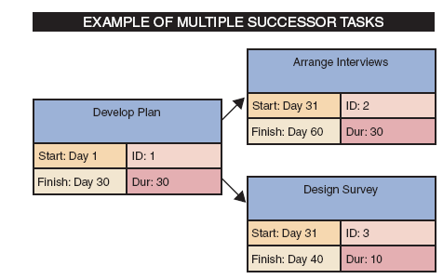
Step 2: Identify Task Patterns(Cont.)
What Are the Main Types of Task Patterns? (cont.)
Multiple Successor Tasks
When several tasks can start at the same time
Each is called a concurrent task
Often, two or more concurrent tasks depend on a single prior task, which is called a predecessor task
FIGURE 3-16 This example of multiple successor tasks shows that the finish time for Task 1 determines the start time for both Tasks 2 and 3

Slide 28
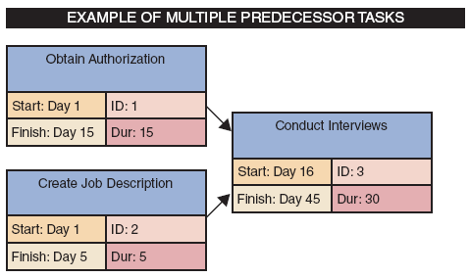
Step 2: Identify Task Patterns(Cont.)
What Are the Main Types of Task Patterns? (cont.)
Multiple Predecessor Tasks
When a task requires two or more prior tasks to be completed before it can start
FIGURE 3-17 This example of multiple predecessor tasks shows that the start time for a successor task must be the latest (largest) finish time for any of its preceding tasks. In the example shown, Task 1 ends on Day 15, while Task 2 ends on Day 5, so Task 1 controls the start time for Task 3

Slide 29
Step 2: Identify Task Patterns(Cont.)
How Do I Identify Task Patterns?
Words like then, when, or and are action words that signal a sequence of events
Do Task 1, then do Task 2
Describes dependent tasks that must be completed one after the other
When Task 2 is finished, start two tasks
Task 3 and Task 4 describes multiple successor tasks that can both start as soon as Task 2 is finished
When Tasks 5 and 6 are done, start Task 7
Indicates that Task 7 is a multiple predecessor task because it can’t start until two or more previous tasks all are completed

Slide 30
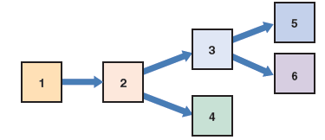

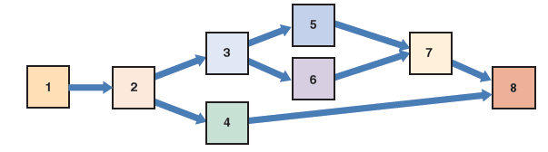
Step 2: Identify Task Patterns(Cont.)
How Do I Work With Complex Task Patterns?
Study the facts very carefully to understand the logic and sequence
Schedule will be wrong if task patterns are incorrect
FIGURE 3-19 Dependent tasks and multiple successor tasks
FIGURE 3-18 Dependent tasks
FIGURE 3-20 Dependent tasks, multiple successor tasks, and multiple predecessor tasks

Slide 31
Step 3: Calculate the Critical Path
What is a Critical Path?
A series of tasks which, if delayed, would affect the completion date of the overall project
If any task on the critical path falls behind schedule, the entire project will be delayed

Slide 32
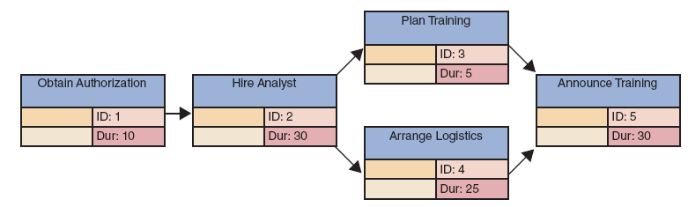
Step 3: Calculate the Critical Path (Cont.)
How Do I Calculate the Critical Path?
Review patterns, determine start and finish dates, which will determine the critical path
FIGURE 3-21 Example of a PERT/CPM chart with five tasks. Task 2 is a dependent task that has multiple successor tasks. Task 5 has multiple predecessor tasks. In this figure, the analyst has arranged the tasks and entered task names, IDs, and durations

Slide 33
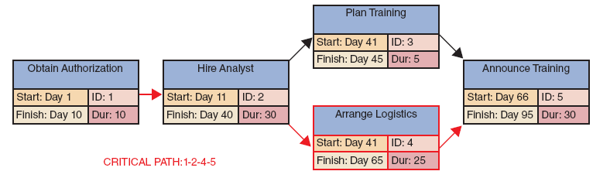
Step 3: Calculate the Critical Path (Cont.)
FIGURE 3-22 Now the analyst has entered the start and finish times, using the rules explained in this section. Notice that the overall project has a duration of 95 days

Slide 34
Project Monitoring and Control
Monitoring and Control Techniques
Structured walkthrough
Maintaining a Schedule
Most projects tune into some problems or delays
Anticipate problems
Avoid them
Minimize their impact
Identify potential solutions
Select the best way to solve the problem

Slide 35
Reporting
Project Status Meetings
Schedule regular meetings to update the team and discuss project status, issues, problems, and opportunities
Project Status Reports
Reports can be verbal but are usually written
Gantt charts are often included to show project status graphically
Handling potential problems can be difficult
An overly cautious project manager who alerts management to every potential snag and slight delay will lose credibility over a period of time, and management might ignore potentially serious situations
A project manager who tries to handle all situations single-handedly and does not alert management until a problem is serious leaves little time to react or devise a solution

Slide 36
Project Management Examples
PERT/CPM Example
STEP 1: DISPLAY THE TASKS AND TASK PATTERNS
Identify the tasks, determine task dependencies, and enter the task name, ID, and duration.
STEP 2: ENTER STAR T AND FINISH TIMES
Enter the start and finish times

Slide 37
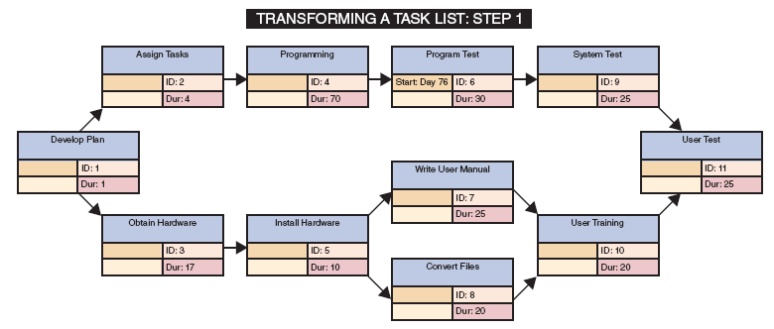
Project Management Examples (Cont.)
FIGURE 3-26 To transform a task list into a PERT/CPM chart, you first enter the task name, ID, duration, and predecessors for each task. Notice that this example includes dependent tasks, tasks with multiple successors, and tasks with multiple predecessors

Slide 38
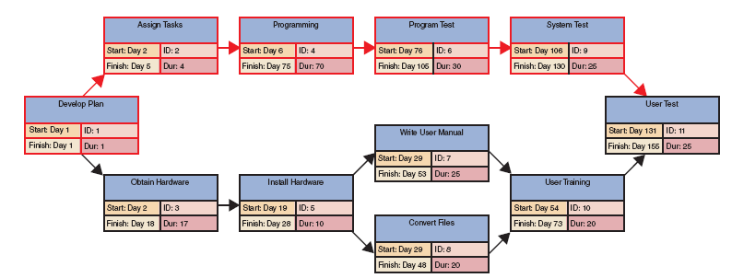
Project Management Examples (Cont.)
FIGURE 3-27 To complete the PERT/CPM chart, you apply the guidelines explained in this section. For example, Task 1 has a one-day duration, so you enter the start and finish for Task 1 as Day 1. Then you enter Day 2 as the start for successor Tasks 2 and 3

Slide 39
Project Management Software
Microsoft Project is a full-featured program that holds the dominant share of the market
Gantt chart
As you enter the tasks, the program automatically performs the calculations, detects the task patterns, and creates a Gantt chart
Network diagram
View is similar to a PERT Chart
Calendar view
View is similar to a PERT chart as an overlay on a calendar
GanttProject is a free, open source program

Slide 40
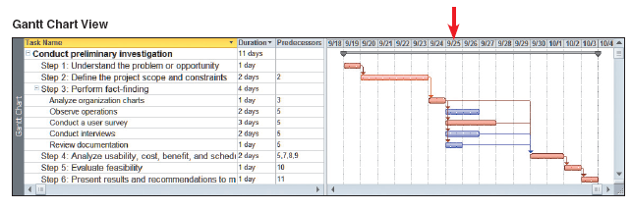
Project Management Software (Cont.)
FIGURE 3-30 Notice how each view displays the project and highlights the critical path. If you were the project manager on September 25, what would be your primary concern?

Slide 41
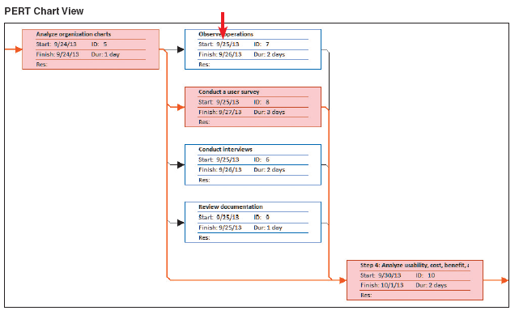
Project Management Software (Cont.)
FIGURE 3-30 Notice how each view displays the project and highlights the critical path. If you were the project manager on September 25, what would be your primary concern?

Slide 42
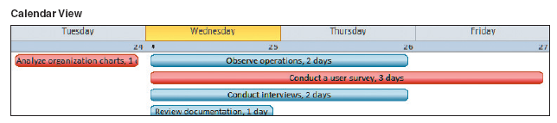
Project Management Software (Cont.)
FIGURE 3-30 Notice how each view displays the project and highlights the critical path. If you were the project manager on September 25, what would be your primary concern?

Slide 43
Risk Management
Steps in Risk Management
Develop a risk management plan
Review of the project’s scope, stakeholders, budget, schedule, and any other internal or external factors that might affect the project
Define project roles and responsibilities, risk management methods and procedures, categories of risks, and contingency plans

Slide 44
Risk Management (Cont.)
Steps in Risk Management (Cont.)
Identify the risks
List each risk and assesses the likelihood that it could affect the project
Analyze the risks
This typically is a two-step process
Qualitative risk analysis evaluates each risk by estimating the probability that it will occur and the degree of impact
Quantitative risk analysis is to understand the actual impact in terms of dollars, time, project scope, or quality

Slide 45
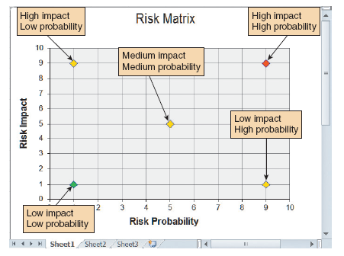
Risk Management (Cont.)
FIGURE 3-33 You can use a Microsoft Excel XY chart type to display a risk matrix that shows risk probability and potential impact.

Slide 46
Risk Management (Cont.)
Risk Management Software
Assigns specific dates as constraints
Aligns task dependencies
Notes external factors that might affect a task
Tracks progress
Displays tasks that are behind schedule
Links risks with specific tasks and projects
Specifies probability and impact
Assigns ownership
Tracks progress to manage projects more efficiently

Slide 47
Managing for Success
Business Issues
Every system is to provide a solution to a business problem or opportunity
If a system does not do this, it is a failure
Budget Issues
Unrealistic estimates that are too optimistic or based on incomplete information
Failure to develop an accurate forecast that considers all costs over the life of the project
Poor monitoring of progress and slow response to early warning signs of problems
Schedule delays due to factors that were not foreseen
Human resource issues, including turnover, inadequate training, and motivation

Slide 48
Managing for Success (Cont.)
Schedule Issues
Problems with timetables and project milestones can indicate a failure to recognize task dependencies, confusion between effort and progress, poor monitoring and control methods, personality conflicts among team members, or turnover of project personnel
The failure of an IT project also can be caused by poor project management techniques

Slide 49
The Bottom Line
Project managers must be alert, technically competent, and highly resourceful. They also must be good communicators with strong human resource skills
When problems occur, the project manager’s ability to handle the situation becomes the critical factor

Slide 50
Chapter Summary
Project management is the process of planning, scheduling, monitoring, and reporting on the development of an information system
A successful project must be completed on time, within budget, and deliver a quality product that satisfies users and meets requirements
A project triangle shows three legs: project cost, scope, and time. A project manager must find the best balance among these elements because a change in any leg of the triangle will affect the other two legs

Slide 51
Chapter Summary (Cont.)
Planning, scheduling, monitoring, and reporting all take place within a larger project development framework, which includes three key steps: creating a work breakdown structure, identifying task patterns, and calculating the critical path
Task patterns establish the sequence of work in a project
A critical path is a series of tasks that, if delayed, would affect the completion date of the overall project

Slide 52
Chapter Summary (Cont.)
A Gantt chart is a horizontal bar chart that represents the project schedule with time on the horizontal axis and tasks arranged vertically
A PERT/CPM chart shows the project as a network diagram with tasks connected by arrows
Most project managers use powerful software such as Microsoft Project to plan, schedule, and monitor projects

